Slide 1
Representing Relations
The Pigeonhole Principle
Course Code: 00090
Course Title: Discrete Mathematics
Dept. of Computer Science
Faculty of Science and Technology
Lecturer No: | 14 | Week No: | 8 | Semester:
Lecturer: | Name & email

Slide 2
Lecture Outline
7.3 Representing Relations
Representing Relations using Matrices (zero-one matrices)
Representing Relations using Directed graph (Digraph)
5.2 The Pigeonhole Principle

Slide 3
Objectives and Outcomes
Objectives: To understand how to represent a relation using a zero-one matrix and directed graph (digraph), to understand the Pigeonhole principle and it’s applications.
Outcomes: The students are expected to be able represent a relation using a zero-one matrix and digraph; be able to determine whether a relation is reflexive, symmetric, antisymmetric, and/or transitive by analyzing a zero-one matrix or digraph that represents the relation; be able to explain the Pigeonhole principle and and its applications.

Slide 4
Representing Relations
There are many ways to represent a relation between finite sets. One way is to list its ordered pairs, another way is to use a table (we have covered those already)
In this section we will discuss two alternative methods of representing relations –
  Representing Relations using Matrices (zero-one matrices)
  Representing Relations using Directed graph (Digraph)
All Relations we study in this section are Binary Relations.

Slide 5
Representing Relations Using Matrices
A relation between finite sets can be represented using a zero-one matrix.
Suppose R is a relation from A = {a₁, a₂, …, a_{m}} to B = {b₁, b₂,…, b_{n}}
  The elements of the two sets can be listed in any particular arbitrary order. When A = B, we use the same ordering.
The relation R is represented by the matrix M_{R} = [m_{ij}], where
The matrix representing R has a 1 as its (i,j) entry when a_{i} is related to b_{j} and a 0 if a_{i} is not related to b_{j}.

Slide 6
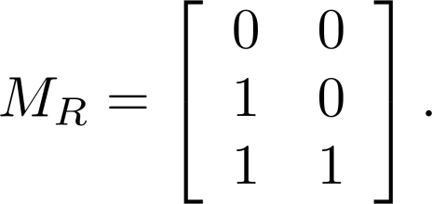
Representing Relations Using Matrices: Example 1
Example 1: Suppose that A = {1,2,3} and B = {1,2}.
Let R be the relation from A to B containing (a, b) if a ∈ A,
b ∈ B, and a > b. What is the matrix representing R (assuming the ordering of elements is the same as the increasing numerical order)?
Solution: Because R = {(2,1), (3,1),(3,2)}, the matrix is
Note: The matrix of a relation R from A to B is dependent on the orderings of the A and B

Slide 7
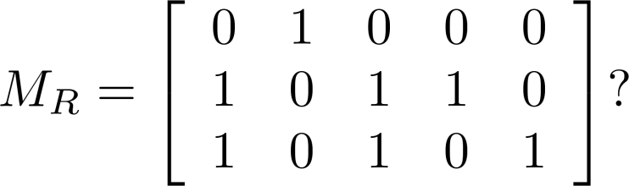
Representing Relations Using Matrices: Example 2
Example 2: Let A = {a₁,a₂, a₃} and B = {b₁,b₂, b₃,b₄, b₅}.
Which ordered pairs are in the relation R represented by the
matrix
Solution: Because R consists of those ordered pairs (a_{i},b_{j}) with
m_{ij} = 1, it follows that:
R = {(a₁, b₂), (a₂, b₁),(a₂, b₃), (a₂, b₄),(a₃, b₁), {(a₃, b₃), (a₃, b₅)}

Slide 8
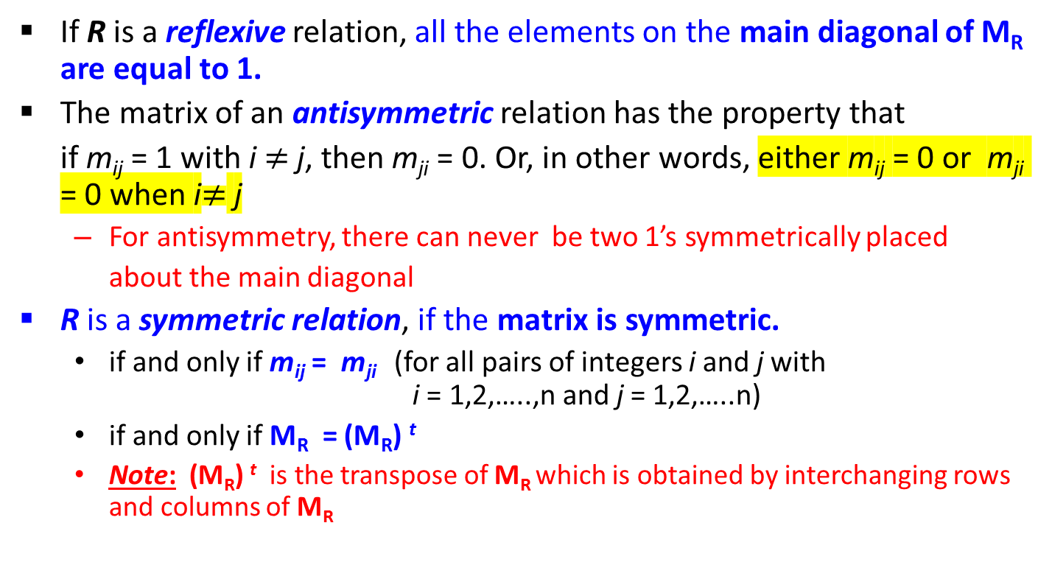
Matrices of Relations on Sets
If R is a reflexive relation, all the elements on the main diagonal of M_{R} are equal to 1.
The matrix of an antisymmetric relation has the property that
if m_{ij} = 1 with i $≠$ j, then m_{ji} = 0. Or, in other words, either m_{ij} = 0 or m_{ji} = 0 when i$≠$ j
  For antisymmetry, there can never be two 1’s symmetrically placed
about the main diagonal
R is a symmetric relation, if the matrix is symmetric.
  if and only if m_{ij} = m_{ji} (for all pairs of integers i and j with i = 1,2,…..,n and j = 1,2,…..n)
  if and only if M_{R} = (M_{R}) ^{t}
  Note: (M_{R}) ^{t} is the transpose of M_{R} which is obtained by interchanging rows and columns of M_{R}

Slide 9
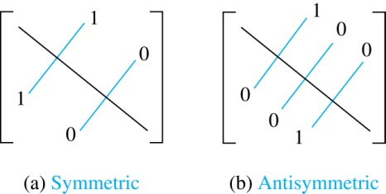
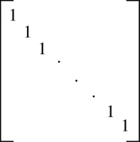
Zero-One Matrices for
Different Types of Relations
Reflexive

Slide 10
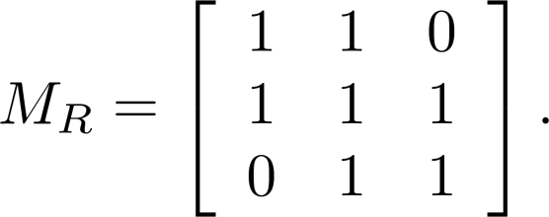
Example of a Relation on a Set
Example 3: Suppose that the relation R on a set is
represented by the matrix
Is R reflexive, symmetric, and/or antisymmetric?
Solution: Because all the diagonal elements are equal to 1, R is reflexive.
Because M_{R} is symmetric, R is symmetric.
R is not antisymmetric because both m_{1,2} and m_{2,1} are 1.

Slide 11
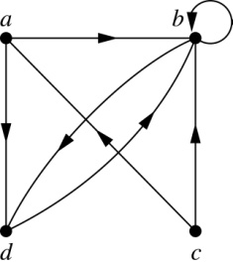
Representing Relations Using Digraphs
Definition: A directed graph, or digraph, consists of a set V of vertices
(or nodes) together with a set E of ordered pairs of elements of V
called edges (or arcs). The vertex a is called the initial vertex of the
edge (a, b), and the vertex b is called the terminal vertex of this edge.
  An edge of the form (a, a) is called a loop.
Example 7: A drawing of the directed graph with vertices a, b, c, and
d, and edges (a, b), (a, d), (b, b), (b, d), (c, a), (c, b), and (d, b) is shown
below.

Slide 12
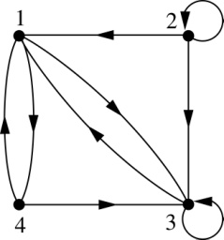
Representing Relations Using Digraphs: Example
Example: What are the ordered pairs in the
relation represented by this directed graph?
Solution: The ordered pairs in the relation are
(1, 3), (1, 4), (2, 1), (2, 2), (2, 3), (3, 1), (3, 3), (4, 1), (4, 3)

Slide 13
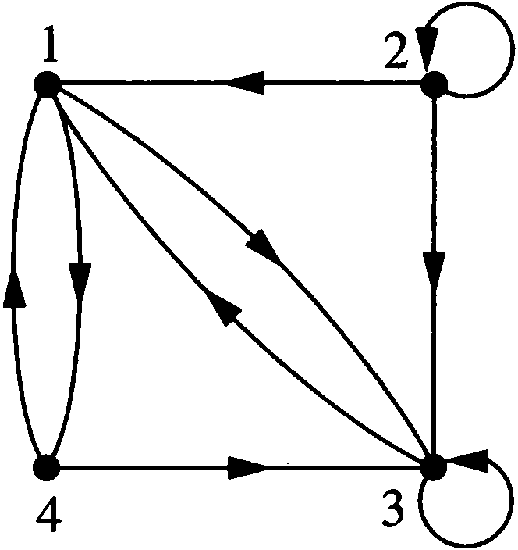
Representing Relations Using Digraphs: Example
Example 9 : What are the ordered pairs in the relation R represented by this graph?
Solution:
R = {(1,3), (1,4), (2,1), (2,2), (2,3), (3,1), (3,3), (4,1), (4,3)}

Slide 14
Determining which Properties, a Relation has from its Digraph
Reflexivity: A loop must be present at ALL vertices in the graph.
Symmetry: If (a, b) is an edge, then so is (b, a).
Antisymmetry: Between any two vertices there is at most one directed edge.
Transitivity: If (a, b) and (b, c) are edges, then so is (a, c).

Slide 15
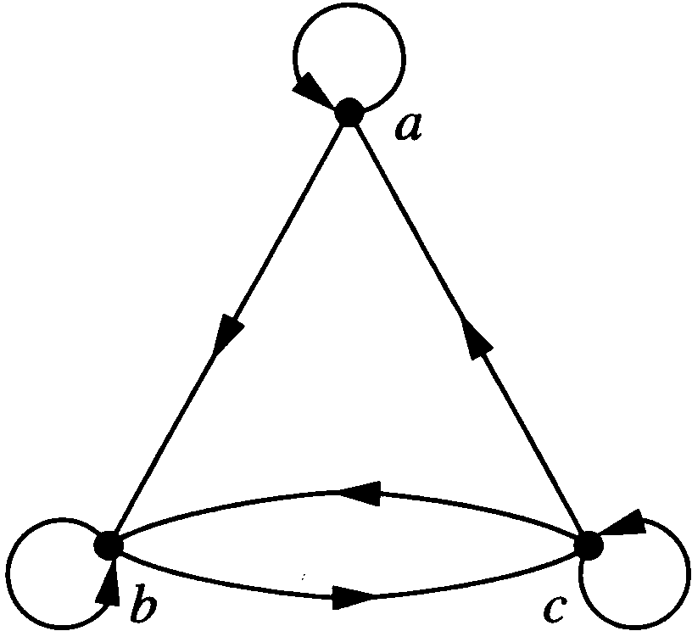
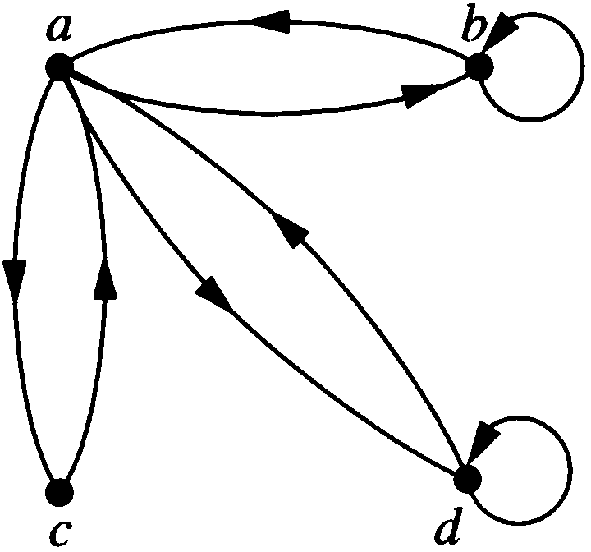
Example of a Relation on a Set
Example 10: Determine whether the relations for the directed graphs shown below are reflexive, symmetric, antisymmetric,
and/or trainsitive. [Solution ➔ next slide]
(a) Directed graph of R
(b) Directed graph of S

Slide 16
Solution of Example 10
Solution of (a):
Reflexive; because there are loops at every vertex
Not symmetric; because there is an edge from a to b, but not one from b to a
Not antisymmetric; because there is an edge from b to c and an edge from c to b
Not transitive; because there is an edge from a to b and an edge from b to c, but no edge from a to c.

Slide 17
Solution of Example 10
Solution of (b):
Not Reflexive; because loops are not present at every vertex.
Symmetric; because every edge between distinct vertices is accompanied by an edge in the opposite direction.
Not antisymmetric; because there is an edge from a to b and an edge from b to a.
Not transitive; because (c, a ) and (a, b ) belongs to S,
but (c, b) does not belong to S

Slide 18
Class Work
Draw the digraph and the matrix of the relation
R = {(1, 2), (1, 3), (2, 2), (2, 1), (3, 2), (3, 4), (4, 1),
(4, 2), (4, 4)} on the set A = {1, 2, 3, 4}.
Try it out yourself!

Slide 19
Practice @ Home
Relevant Odd-Numbered Exercises from
your text book

Slide 20
5.2 The Pigeonhole Principle
If there are more pigeons than pigeonholes, then there must be at least one pigeonhole with at least two pigeons in it.
Theorem 1: (The Pigeonhole Principle) If k is a positive integer and k+1 or more objects are placed into k boxes, then there is at least one box containing two or more of the objects.
  Proof (by contraposition)
  Also called the Dirichlet (duh·ri·klet) drawer principle

Slide 21
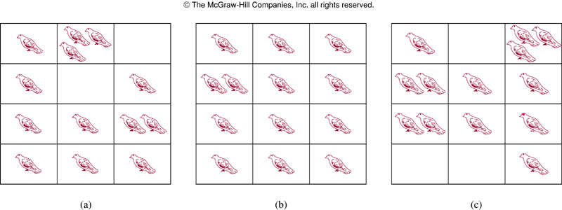
FIGURE 1 : There Are More Pigeons Than Pigeonholes

Slide 22
The Pigeonhole Principle
  The Pigeonhole Principle can be used to prove a useful corollary (kuh·ro·luh·ree) about functions.
Corollary 1: A function from a set with k + 1 or more elements to a set with k elements is not one-to-one.
Example 1 (p. 348): Among any group of 367 people, there must be at least two with the same birthday, because there are only 366 possible birthdays.

Slide 23
The Generalized Pigeonhole Principle
Theorem 2 (The Generalized Pigeonhole Principle): If N objects are placed into k boxes, then there is at least one box containing at least ⎡N/k⎤ objects.
Example 5 (p.349): Among 100 people there are at least ⎡100/12⎤ = 9 who were born in the same month.

Slide 24
Example 6
What is the minimum number of students required in a discrete mathematics class to be sure that at least six will receive the same grade, if there are five possible grades, A, B, C, D, and F?
Solution: The minimum number of students needed to ensure that at least six students receive the same grade is the smallest integer N such that ⎡N /5⎤ = 6.
The smallest such integer is N = 5x5 + 1 = 26.
Note: ⎡N/5⎤ ≥ 6, or, N ≥ 5x5 +1, or, N ≥ 26
N _{smallest} = 26

Slide 25
Example 6
What is the minimum number of students required in a discrete mathematics class to be sure that at least six will receive the same grade, if there are five possible grades, A, B, C, D, and F?

Slide 26
Class Work: Exercise 31
Exercise 31: There are 38 different time periods during which classes at a university can be scheduled. If there are 677 different classes, how many different rooms will be needed?
Solution: Try it out!

Slide 27
Solution of Exercise 31
Solution: Thinks that the 38 time periods are the
pigeonholes, and the 677 classes are the pigeons.
By the generalized pigeonhole principle there is some
time period in which at least ⎡677 /38⎤ = 18 classes are
meeting.
Since each class must meet in a different room, we need
18 rooms.

Slide 28
Practice @ Home
Relevant Odd-Numbered Exercises from your text book

Slide 29
Books
Rosen, K. H., & Krithivasan, K. (2012). Discrete mathematics and its applications: with combinatorics and graph theory. Tata McGraw-Hill Education. (7th Edition)

Slide 30
References
Discrete Mathematics, Richard Johnsonbaugh, Pearson education, Inc.
Discrete Mathematical Structures, Bernard Kolman, Robert C. Busby, Sharon Ross, Prentice-Hall, Inc.
SCHAUM’S outlines Discrete Mathematics(2nd edition), by Seymour Lipschutz, Marc Lipson
Online tutorial
https://www.tutorialspoint.com/discrete_mathematics/discrete_mathematics_relations.htm
University of Pittsburgh
https://people.cs.pitt.edu/~milos/courses/cs441/lectures/Class21b.pdf
Online tutorial
https://www.geeksforgeeks.org/discrete-mathematics-the-pigeonhole-principle/
National Tsing Hua University
http://www.cs.nthu.edu.tw/~wkhon/math/lecture/lecture06.pdf

